Slide 1


Assessing Fairness in Classification Parity of Machine Learning Models in Healthcare
Ming Yuan², Vikas Kumar¹, Muhammad Aurangzeb Ahmad^{1,3} and Ankur Teredesai^{1,2}
¹KenSci Inc
²Department of Computer Science, University of Washington, Tacoma
³Department of Computer Science, University of Washington, Bothell
AAAI 2020 Fall Symposium of AI for Social Good
Notes:
Hello everyone and thank you to the members of organizing committee for putting together this symposium on an important topic.. My name is Vikas Kumar. I oversee a research team of data scientists and engineers at KenSci, a startup company based out of Seattle where we focus in the area of machine learning applications in healthcare.
Today, I will walk you through one of the ways of assessment of fairness we explored in classification models for healthcare and what we did to improve the fairness in the results.
A Special shout out to Ming Yuan for her key contributions and effort in this paper. Ming was student at UW Tacoma and worked with us at KenSci as an Intern. Unfortunately, she was not able to join us today. Also would like to thank Muhammad and Ankur for their guidance and inputs throughout this work.

Slide 2
“We are concerned about the constant use of federal funds to support this most notorious expression of segregation. Of all the forms of inequality, injustice in health is the most shocking and the most inhuman because it often results in physical death.”
- Reverend Martin Luther King Jr. (Chicago, March 25, 1966)
Source: newspaper article reports, 1966 https://quoteinvestigator.com/2015/10/22/mlk-health/
Notes:
I would like to start with following statement from Dr. Martin Luther King Jr. from about 54 years ago on impact of injustic in healthcare He said - to quote “ Of all the forms of inequality, injustice in health is the most shocking and inhuman..”

Slide 3
Motivation
Bias, discrimination and unfair practices in healthcare is centuries old
With the integration of AI + Healthcare the potential to discriminate and perpetuate unfair and biased practices in healthcare increases many folds
Healthcare necessitates careful consideration of different notions of fairness in healthcare to different conceptualizations of fairness in AI
Notes:
Bias, discrimination and unfair practices in healthcare are not hypothetical. The impact can be more widespread and varied now due to prevalence and scale of AI applications.
Even more so, it is important to carefully consider different notions of fairness in healthcare to different conceptualizaions of fairness in usual AI.

Slide 4
Fairness in the model build cycle
Metrics
Notes:
In order to understand fairness, we need to look at the sources of bias. Here, we have a simplified view of ML cycle that includes – preprocessing of data, features constructions/selection, choice of models and metrics. To decode fairness, we have to look at every possible source of bias in this spectrum.
And, before I discuss fairness in the context of this spectrum– I want to acknowledge that fairness in healthcare is not only restricted within this. It can be present in the left spectrum of this on the ways data were collected, and right side of this spectrum, based on delivery of care that can lead to unfair and bias outcomes.

Slide 5
Fairness in the model build cycle
*potentially be used to discriminate against a population. Attributes that are protected under Equality Act of 2010: race, gender, ethnicity, etc
Metrics
Use of protected* features
Loss functions
Choice of Thresholds
Representation bias
Removal of protected features (and correlated features)
Optimized loss function
Sampling Strategies
Optimized Threshold
Notes:
In this paper, we focus on this model build cycle for the assessment and evaluation of fairness.
For instance, in data – the issue can be identified due to under-representation of certain cohorts.
In features, it can be identified due to use of protected features such as gender, race, age, etc.
In model, the issue could exist due to the choice of hyperparameters and the loss functions.
Finally, in metrics, the choice of thresholds that could result to biased or unfair results.
We specifically looked at some of these stages to assess and address the fairness issue. For instance, optimizing the thresholds, removal of protected features, as well as sampling strategies to identify as well as reduce any biased or unfair outcomes.
We do not discuss an expanding area of work on identifying optimized loss functions for fair models in this paper.

Slide 6
Experiment Data
Dataset | Description | Size (records x features) | Target Variable | Protected Feature(s)
MIMIC III [Johnson et al., 2016] | Predict hospital length of stay (LOS) | 46630 x 212 | Binary (shorter stay or longer stay) | age, gender, race
Thyroid Disease Dataset [UCI Machine Learning, Garavan Institute et al., 1987] | Predict the state of thyroxine-binding proteins, which is relative to thyroid disease. | 3772 x 29 | Multi-class (negative, increased binding protein, decreased binding protein) | age, gender
Pima Indians Diabetes Dataset (PIMA) [UCI Machine Learning, Smith et al., 1988] | Predict the onset of diabetes based on diagnostic measures (medical predictor variables) | 768 x 9 | Binary (onset or not) | age
Notes:
Coming to the dataset, we included following three dataset for evaluation of fairness. It included MIMIC III dataset for evaluation of fairness in the prediction of whether a patient is likely to stay for shorter or longer period during hospital admission.
Then, the Thyroid Disease Dataset was used to evaluate fairness in prediction of state of thyroxin-binding proteins, which is related to thyroid disease. And, finally the PIMA Indians Diabetes dataset to evaluate fairness in prediction of the onset of diabetes.
notes:
Pima: a group of Native Americans living in an area consisting of what is now central and southern Arizona
Thyroxine-binding proteins is any of several transport proteins that bind thyroid hormone and carry it
around the bloodstream. The state of proteins seems to be relative to thyroid disease.

Slide 7
LOS Dataset Characteristics: Protected Features
0-10% | 10-20%
20-30% | 30-40%
40-50% | 50-60%
60-70% | 70-80%
80-90% | 90-100%
Age Distribution
Gender Distribution
Race Distribution
number
number
number
75.22%
73.45%
75.5%
74.91%
76.76%
80.14%
76.66%
73.38%
77.94%
78.43%
Race Categories
Age Categories
Gender Categories
xx – 40 (11.5%) | 41 – 70 (31.15%) | 71 – xx (57.35%)
Male (57.21%) | Female (42.79%)
White (70.86%) | Black /African American (9.13%) | Hispanic /Latino (2.79%) | Asian (1.5% ) | Other (15.72%)
Notes:
Using the length of stay dataset as an example, we will discuss some of our findings and the results. The results based on other datasets are discussed in detail in the paper.
We start with the characteristics of the LOS dataset with respect to protected features of age, gender, and race. This is the distribution and categories of age. In the distribution chart, the gray bar represents patients with shorter stay and the blue bar represents item with longer stay. We can see the distribution of age to vary significantly across these three buckets.
The second is of gender distribution where we see more male in the data than female, and finally the distribution and categories of race. We can see here how the data has under or relatively zero representation for race other than White. It is important to note that although this data can be seen as close to actual distribution of these races in actual population but over-representation of certain groups in ML models can make a model more biased towards that group.

Slide 8
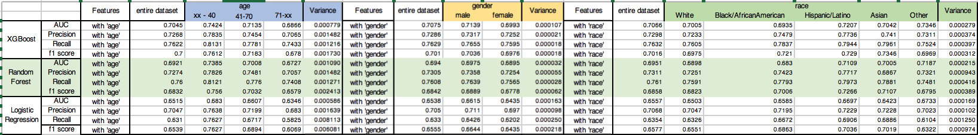
LOS Model Fairness
Race: the performance vary significantly between different races
Results: Race
Notes:
And, we can see that bias in the model performance here. We observed differences in the AUC of model to differ across different races.

Slide 9
LOS Metrics: Fairness Threshold, Performance Boundary
Protected features: gender; Before sampling; With all the features
Entire Dataset
Male
Female
Notes:
Now we look at how the choice of thresholds can help assess fairness in the models. Here we are looking at different threshold that are selected based on Youden’s statistics from different cohorts of data. For instance the threshold for classification based on entire dataset, then threshold based on only male or female cohort. We also determine thresholds that combine two protected attributes cohort.
To understand if the model is fair across the gender attribute, we look at the differences in the precision of the model based on these different thresholds.
The graph below shows the precision metric for the model against different thresholds on x-axis. The three colored dots in vertical line represent the precision of model across three cohorts against the selected threshold. Lower the difference or the variance in the vertical dots, more fair the model is considered across the cohorts. Note that although differences in precision here are less than 1%, we are looking at a dataset of about 47K patients, which translates into at least 500 patients likely to be treated unfairly.
The recentangle box highlights where we found the least variance in the precision of model among three cohorts based on the selected threshold.

Slide 10
Before Sampling:
After Sampling, the differences in performance across categories reduce.
After Sampling:
Notes:
In these plots, the change in the variance is shown between when data used for the model without sampling and then after sampling. We see than balancing the representation of gender reduces the variance or difference in the performance of models across cohort. This can be seen by reduced gap between the colored dots in vertical scale.

Slide 11
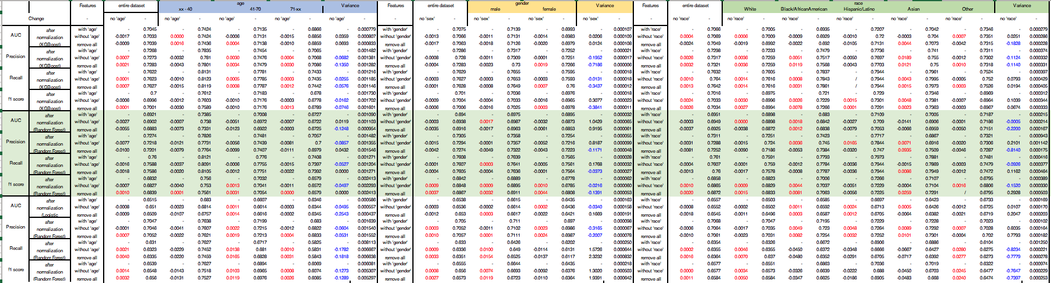
LOS: Model Fairness and Absence of Protected Features
AGE
the variance of the performance is more likely to decrease (10% - 30%)
Notes:
Similar results are observed across AGE category, where we saw that sampling of data for each age category as well as removing the protected attributes from the model resulted in reduced differences in the performance of model across the age categories by almost 10-30%

Slide 12
LOS: Model Fairness and Absence of Protected Features
RACE
the variance of the performance is more likely to decrease (10% - 30%, sometimes over 60%)
Notes:
This is the results of ethnicity. We again We could see the variance of the performance could decrease even higher than 60% by applying similar sampling method and removing the ethnicity from the model.

Slide 13
LOS: Model Fairness and Absence of Protected Features
The performance does not show significant change, while it is more likely to increase a bit (mostly increase under 5%)
Notes:
Talking about the performance of model overall, we did not see any significant change after sampling and removal of protected attributes.

Slide 14
Algorithms/Models
Accuracy (AUC score):
Logistic regression < Random Forest < XGBoost
Variance in AUC score for protected feature: (smaller variance => more fair)
Logistic regression < Random Forest < XGBoost (Race)
Notes:
(13:00)
Finally, related to the fairness in the three methods used in training the models.
XGBoost was found to be the most accurate model while the logistic regression is the least accurate one.
However, if we compare the variance in AUC score, we could see Logistic regression has more fair performance, that is smaller variance, and XGBoost has the least fair performance.
This suggests that an accurate model does not necessarily imply fair outcomes.

Slide 15
Key Takeaways
Assessing fairness is a multifaceted problem:
Bias due to threshold
Bias due to choice of algorithms
Bias due to features
Bias due to data
Improving fairness:
Identify and remove protected* attributes
Optimize thresholds
Balance representations in the data
Notes:
As key takeways from this work, we can see that assessing fairness is a multifaceted problem.
However, these biases can be identifed and fairness can be improved in the models by following some very simple techniques - including removal of prototected features, optimizing thresholds, and sampling to balance for the under-represented cohorts in the data.

Slide 16

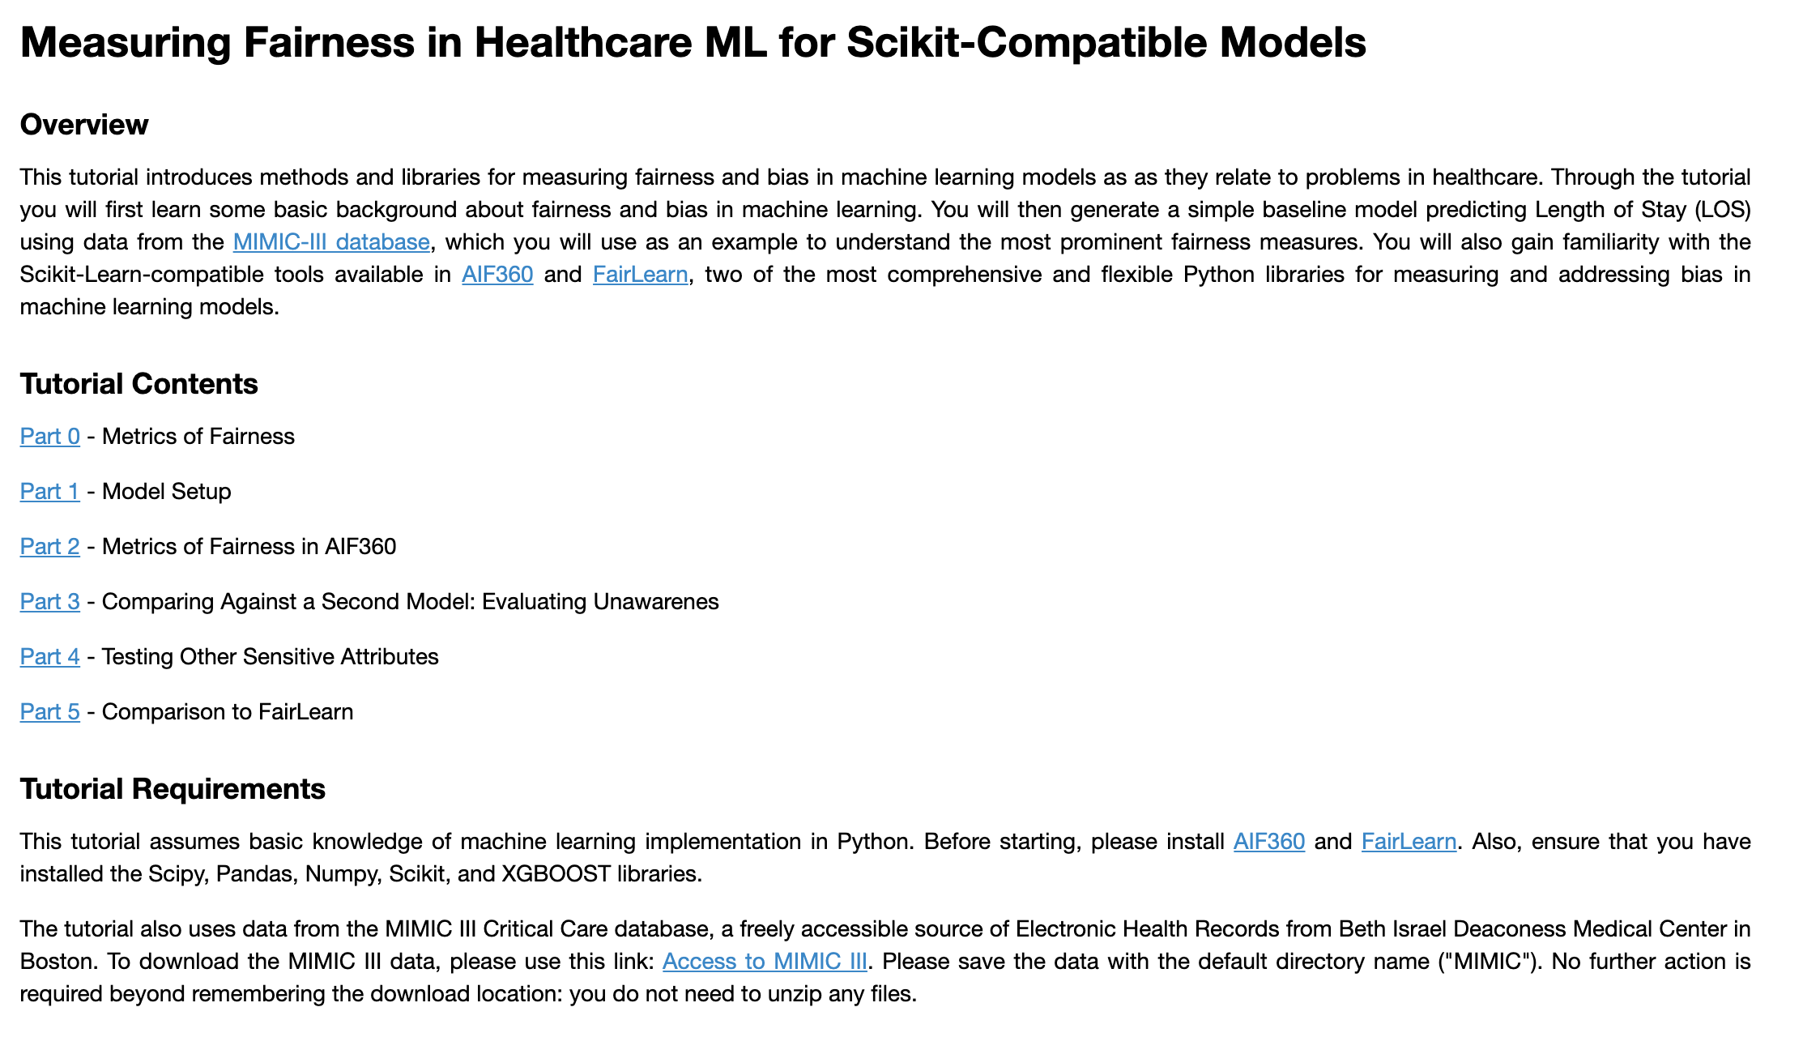



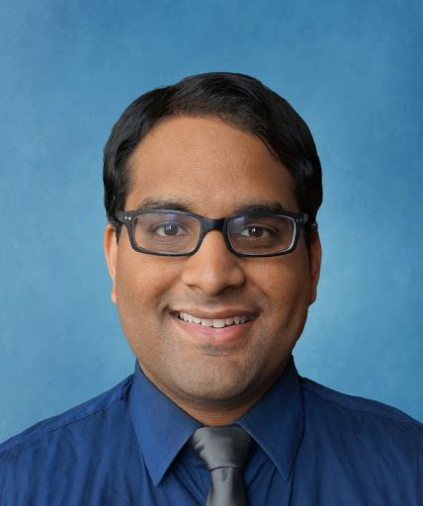



FairMLHealth Library
https://github.com/KenSciResearch/fairMLHealth
Notes:
I want to conclude today by sharing about the fairML health library that KenSci team has released this month. This library is a python package that can be used to evaluate multiple fairness metrics on any scikit-learn compatible model.
You can also find more details about the package and its demo on MIMIC 3 data in Jupyter notebook and tutorial slides that Muhammad and team recently presented at KDD conference in July this year.

Slide 17

Call to Action: Partner with us! It takes a village
Deployment of Enterprise grade AI and ML models in healthcare at multiple locations in the US and internationally
Studying fairness across multiple locations, settings and cohort
https://www.kensci.com/about/careers/

